Slide 1
Class 14 – Page Replacement
Osama Hosam Eldeen
Taiba University

Slide 2
Page replacement
Assume a normal page table (e.g., BLITZ)
User-program is executing
A PageInvalidFault occurs!
  The page needed is not in memory
Select some frame and remove the page in it
  If it has been modified, it must be written back to disk
    the “dirty” bit in its page table entry tells us if this is necessary
Figure out which page was needed from the faulting addr
Read the needed page into this frame
Restart the interrupted process by retrying the same instruction

Slide 3
Page replacement algorithms
Which frame to replace?
Algorithms:
  The Optimal Algorithm
  First In First Out (FIFO)
  Not Recently Used (NRU)
  Second Chance / Clock
  Least Recently Used (LRU)
  Not Frequently Used (NFU)
  Working Set (WS)
  WSClock

Slide 4
The optimal page replacement algorithm
Idea:
  Select the page that will not be needed for the longest time

Slide 5
Optimal page replacement
Replace the page that will not be needed for the longest
Example:
Time 0 1 2 3 4 5 6 7 8 9 10
Requests c a d b e b a b c d
Page 0 a
Frames 1 b
2 c
3 d
Page faults
a a a a
b b b b
c c c c
d d d d
X

Slide 6
Optimal page replacement
Select the page that will not be needed for the longest time
Example:
Time 0 1 2 3 4 5 6 7 8 9 10
Requests c a d b e b a b c d
Page 0 a
Frames 1 b
2 c
3 d
Page faults
a a a a a a a a a
b b b b b b b b b
c c c c c c c c c
d d d d e e e e e
X X

Slide 7
The optimal page replacement algorithm
Idea:
  Select the page that will not be needed for the longest time
Problem?

Slide 8
The optimal page replacement algorithm
Idea:
  Select the page that will not be needed for the longest time
Problem:
  Can’t know the future of a program
  Can’t know when a given page will be needed next
  The optimal algorithm is unrealizable

Slide 9
The optimal page replacement algorithm
However:
  We can use it as a control case for simulation studies
    Run the program once
    Generate a log of all memory references
      Do we need all of them?
    Use the log to simulate various page replacement algorithms
    Can compare others to “optimal” algorithm

Slide 10
FIFO page replacement algorithm
Always replace the oldest page …
  “Replace the page that has been in memory for the longest time.”

Slide 11
FIFO page replacement algorithm
Replace the page that was first brought into memory
Example: Memory system with 4 frames:
Time 0 1 2 3 4 5 6 7 8 9 10
Requests c a d b e b a b c a
Page 0 a
Frames 1 b
2 c
3 d
Page faults
a a a
b
c c c c
d d
X

Slide 12
FIFO page replacement algorithm
Replace the page that was first brought into memory
Example: Memory system with 4 frames:
Time 0 1 2 3 4 5 6 7 8 9 10
Requests c a d b e b a b c a
Page 0 a
Frames 1 b
2 c
3 d
Page faults
a a a a a a a
b b b b b
c c c c e e e e
d d d d d d
X X

Slide 13
FIFO page replacement algorithm
Replace the page that was first brought into memory
Example: Memory system with 4 frames:
Time 0 1 2 3 4 5 6 7 8 9 10
Requests c a d b e b a b c a
Page 0 a
Frames 1 b
2 c
3 d
Page faults
a a a a a a a c
b b b b b b
c c c c e e e e e
d d d d d d d
X X X

Slide 14
FIFO page replacement algorithm
Replace the page that was first brought into memory
Example: Memory system with 4 frames:
Time 0 1 2 3 4 5 6 7 8 9 10
Requests c a d b e b a b c a
Page 0 a
Frames 1 b
2 c
3 d
Page faults
a a a a a a a c c
b b b b b b b
c c c c e e e e e e
d d d d d d d a
X X X

Slide 15
FIFO page replacement algorithm
Always replace the oldest page.
  “Replace the page that has been in memory for the longest time.”
Implementation
  Maintain a linked list of all pages in memory
  Keep it in order of when they came into memory
  The page at the tail of the list is oldest
  Add new page to head of list

Slide 16
FIFO page replacement algorithm
Disadvantage?

Slide 17
FIFO page replacement algorithm
Disadvantage:
  The oldest page may be needed again soon
  Some page may be important throughout execution
  It will get old, but replacing it will cause an immediate page fault

Slide 18
How can we do better?
Need an approximation of how likely each frame is to be accessed in the future
  If we base this on past behavior we need a way to track past behavior
  Tracking memory accesses requires hardware support to be efficient

Slide 19
Page table: referenced and dirty bits
Each page table entry (and TLB entry!) has a
  Referenced bit - set by TLB when page read / written
  Dirty / modified bit - set when page is written
  If TLB entry for this page is valid, it has the most up to date version of these bits for the page
    OS must copy them into the page table entry during fault handling
Idea: use the information contained in these bits to drive the page replacement algorithm

Slide 20
Page table: referenced and dirty bits
Some hardware does not have support for the dirty bit
Instead, memory protection can be used to emulate it
Idea:
  Software sets the protection bits for all pages to “read only”
  When program tries to update the page...
    A trap occurs
    Software sets the Dirty Bit in the page table and clears the ReadOnly bit
    Resumes execution of the program

Slide 21
Not recently used page replacement alg.
Uses the Referenced Bit and the Dirty Bit
Initially, all pages have
  Referenced Bit = 0
  Dirty Bit = 0
Periodically... (e.g. whenever a timer interrupt occurs)
  Clear the Referenced Bit
  Referenced bit now indicates “recent” access

Slide 22
Not recently used page replacement alg.
When a page fault occurs...
Categorize each page...
  Class 1: Referenced = 0 Dirty = 0
  Class 2: Referenced = 0 Dirty = 1
  Class 3: Referenced = 1 Dirty = 0
  Class 4: Referenced = 1 Dirty = 1
Choose a victim page from class 1 … why?
If none, choose a page from class 2 … why?
If none, choose a page from class 3 … why?
If none, choose a page from class 4 … why?

Slide 23
Second chance page replacement alg.
An implementation of NRU based on FIFO
Pages kept in a linked list
  Oldest is at the front of the list
Look at the oldest page
  If its “referenced bit” is 0...
    Select it for replacement
  Else
    It was used recently; don’t want to replace it
    Clear its “referenced bit”
    Move it to the end of the list
  Repeat
What if every page was used in last clock tick?
  Select a page at random

Slide 24
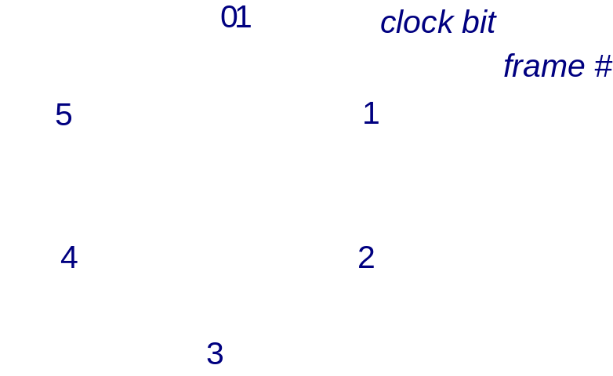
Clock algorithm (an implementation of NRU)
Maintain a circular list of pages in memory
Set a bit for the page when a page is referenced
Clock sweeps over memory looking for a victim page that does not have the referenced bit set
  If the bit is set, clear it and move on to the next page
  Replaces pages that haven’t been referenced for one complete clock revolution – essentially an implementation of NRU

Slide 25
Least recently used algorithm (LRU)
A refinement of NRU that orders how recently a page was used
  Keep track of when a page is used
  Replace the page that has been used least recently

Slide 26
LRU page replacement
Replace the page that hasn’t been referenced in the longest time
Time 0 1 2 3 4 5 6 7 8 9 10
Requests c a d b e b a b c d
Page 0 a
Frames 1 b
2 c
3 d
Page faults

Slide 27
LRU page replacement
Replace the page that hasn’t been referenced in the longest time
Time 0 1 2 3 4 5 6 7 8 9 10
Requests c a d b e b a b c d
Page 0 a
Frames 1 b
2 c
3 d
Page faults
a a a a a a a a a a
b b b b b b b b b b
c c c c e e e e e d
d d d d d d d d c c
X X X

Slide 28
Least recently used algorithm (LRU)
But how can we implement this?

Slide 29
Least recently used algorithm (LRU)
But how can we implement this?
Implementation #1:
  Keep a linked list of all pages
  On every memory reference,
    Move that page to the front of the list
  The page at the tail of the list is replaced

Slide 30
LRU implementation
Take referenced and put at head of list
Time 0 1 2 3 4 5 6 7 8 9 10
Requests c a d b e b a b c d
Page 0 a
Frames 1 b
2 c
3 d
Page faults

Slide 31
LRU implementation
Take referenced and put at head of list
Time 0 1 2 3 4 5 6 7 8 9 10
Requests c a d b e b a b c d
Page 0 a
Frames 1 b
2 c
3 d
Page faults
a a
b b
c c
d d
C
A
B
D
A
C
B
D

Slide 32
LRU implementation
Take referenced and put at head of list
Time 0 1 2 3 4 5 6 7 8 9 10
Requests c a d b e b a b c d
Page 0 a
Frames 1 b
2 c
3 d
Page faults
a a a a
b b b b
c c c c
d d d d
X
C
A
B
D
A
C
B
D
D
A
C
B
B
D
A
C

Slide 33
LRU implementation
Take referenced and put at head of list
Time 0 1 2 3 4 5 6 7 8 9 10
Requests c a d b e b a b c d
Page 0 a
Frames 1 b
2 c
3 d
Page faults
a a a a a a a a a a
b b b b b b b b b b
c c c c e e e e e d
d d d d d d d d c c
X X X
C
A
B
D
A
C
B
D
D
A
C
B
B
D
A
C
E
B
D
A
B
E
D
A
A
B
E
D
B
A
E
D
C
B
A
E
D
C
B
A

Slide 34
Least recently used algorithm (LRU)
But how can we implement this?
  … without requiring “every access” to be recorded?
Implementation #2:
  MMU (hardware) maintains a counter
  Incremented on every clock cycle
  Every time a page table entry is used
    MMU writes the value to the page table entry
    This timestamp value is the time-of-last-use
  When a page fault occurs
    Software looks through the page table
    Idenitifies the entry with the oldest timestamp

Slide 35
Least recently used algorithm (LRU)
What if we don’t have hardware support for a counter?
Implementation #3:
  Maintain a counter in software
  One every timer interrupt...
    Increment counter
    Run through the page table
    For every entry that has “ReferencedBit” = 1
      Update its timestamp
      Clear the ReferencedBit
  Approximates LRU
  If several have oldest time, choose one arbitrarily

Slide 36
Not frequently used algorithm (NFU)
Bases decision of frequency of use rather than recency
Associate a counter with each page
On every clock interrupt, the OS looks at each page.
  If the Reference Bit is set...
    Increment that page’s counter & clear the bit.
The counter approximates how often the page is used.
For replacement, choose the page with lowest counter.

Slide 37
Not frequently used algorithm (NFU)
Problem:
  Some page may be heavily used
    ---> Its counter is large
  The program’s behavior changes
    Now, this page is not used ever again (or only rarely)
  This algorithm never forgets!
    This page will never be chosen for replacement!
  We may want to combine frequency and recency

Slide 38
Modified NFU with aging
Associate a counter with each page
On every clock tick, the OS looks at each page.
  Shift the counter right 1 bit (divide its value by 2)
  If the Reference Bit is set...
    Set the most-significant bit
    Clear the Referenced Bit
      T₁ 100000 = 32
      T₂ 010000 = 16
      T₃ 001000 = 8
      T₄ 000100 = 4
      T₅ 100010 = 34

Slide 39
Working set page replacement
Demand paging
  Pages are only loaded when accessed
  When process begins, all pages marked INVALID

Slide 40
Working set page replacement
Demand paging
  Pages are only loaded when accessed
  When process begins, all pages marked INVALID
Locality of reference
  Processes tend to use only a small fraction of their pages

Slide 41
Working set page replacement
Demand paging
  Pages are only loaded when accessed
  When process begins, all pages marked INVALID
Locality of Reference
  Processes tend to use only a small fraction of their pages
Working Set
  The set of pages a process needs
  If working set is in memory, no page faults
  What if you can’t get working set into memory?

Slide 42
Working set page replacement
Thrashing
  If you can’t get working set into memory page faults occur every few instructions
  Little work gets done
  Most of the CPU’s time is going on overhead

Slide 43
Working set page replacement
Based on prepaging (prefetching)
  Load pages before they are needed
Main idea:
  Try to identify the process’s “working set”
How big is the working set?
  Look at the last K memory references
  As K gets bigger, more pages needed.
  In the limit, all pages are needed.

Slide 44
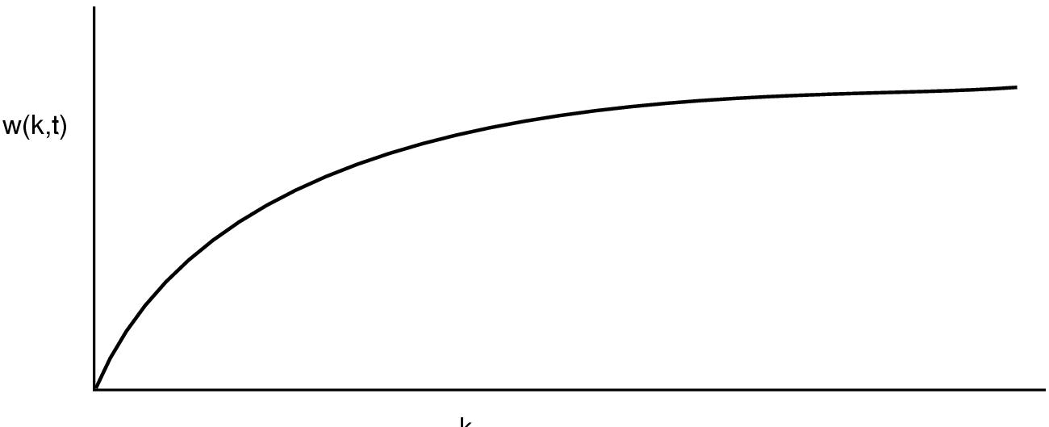
Working set page replacement
The size of the working set:
k (the time interval)

Slide 45
Working set page replacement
Idea:
  Look back over the last T msec of time
  Which pages were referenced?
    This is the working set.
Current Virtual Time
  Only consider how much CPU time this process has seen.
Implementation
  On each clock tick, look at each page
  Was it referenced?
    Yes: Make a note of Current Virtual Time
  If a page has not been used in the last T msec,
    It is not in the working set!
    Evict it; write it out if it is dirty.

Slide 46
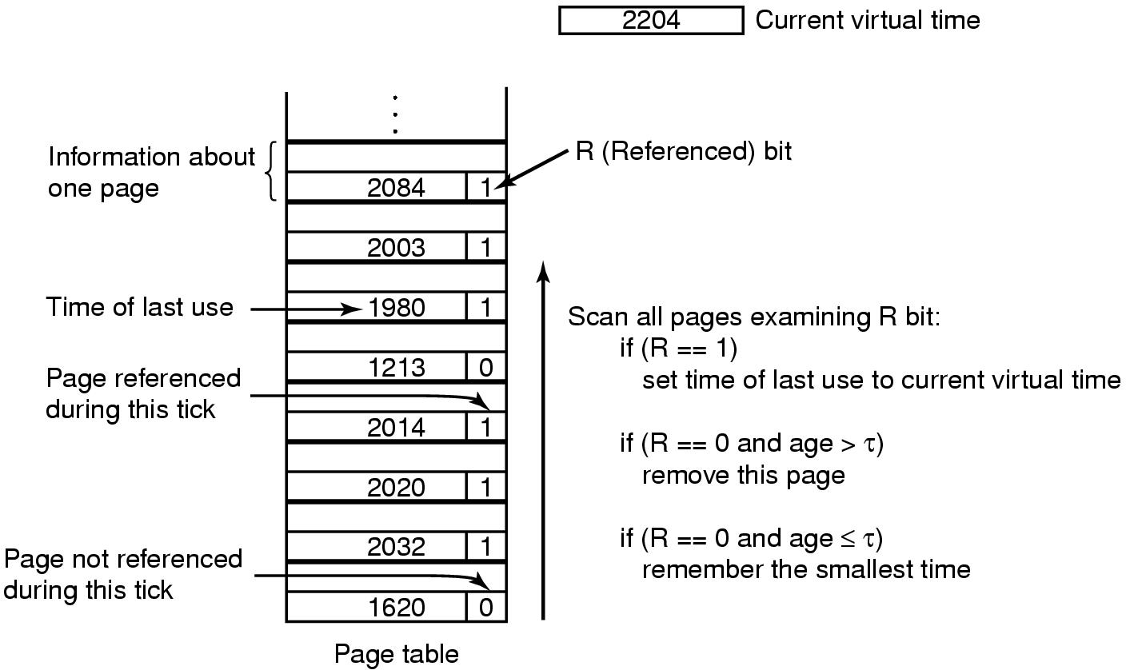
Working set page replacement
a

Slide 47
WSClock page replacement algorithm
An implementation of the working set algorithm
All pages are kept in a circular list (ring)
As pages are added, they go into the ring
The “clock hand” advances around the ring
Each entry contains “time of last use”
Upon a page fault...
  If Reference Bit = 1...
    Page is in use now. Do not evict.
    Clear the Referenced Bit.
    Update the “time of last use” field.

Slide 48
WSClock page replacement algorithm
If Reference Bit = 0
  If the age of the page is less than T...
    This page is in the working set.
    Advance the hand and keep looking
  If the age of the page is greater than T...
    If page is clean
      Reclaim the frame and we are done!
    If page is dirty
      Schedule a write for the page
      Advance the hand and keep looking

Slide 49
But which algorithm is best?

Slide 50
Comparing algorithms through modeling
Run a program
  Look at all memory references
  Don’t need all this data
  Look at which pages are accessed
    0000001222333300114444001123444
  Eliminate duplicates
    012301401234
This defines the Reference String
  Use this to evaluate different page replacement algorithms
  Count page faults given the same reference string

Slide 51
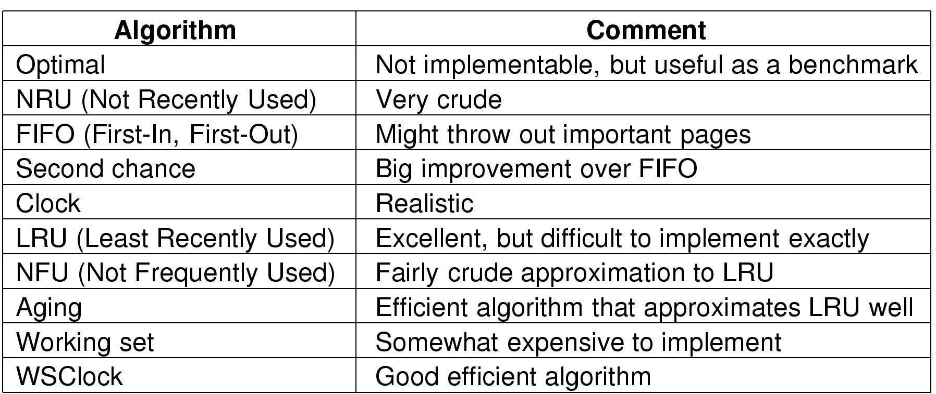
Summary

Slide 52
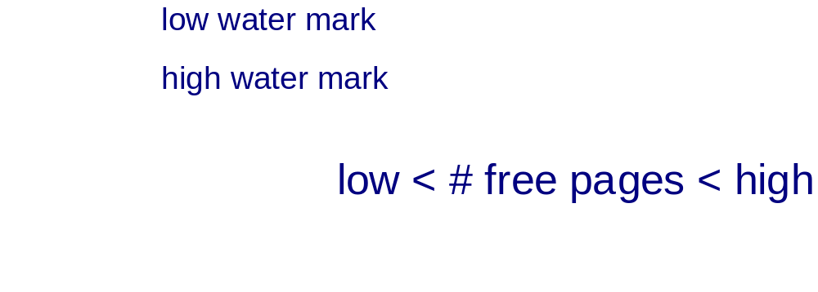
Proactive use of replacement algorithm
Replacing victim frame on each page fault typically requires two disk accesses per page fault
Alternative → the O.S. can keep several pages free in anticipation of upcoming page faults.
  In Unix: low and high water marks

Slide 53
Free pages and the clock algorithm
The rate at which the clock sweeps through memory determines the number of pages that are kept free:
  Too high a rate --> Too many free pages marked
  Too low a rate --> Not enough (or no) free pages marked
Large memory system considerations
  As memory systems grow, it takes longer and longer for the hand to sweep through memory
  This washes out the effect of the clock somewhat

Slide 54
The UNIX memory model
UNIX page replacement
  clock algorithm for page replacement
    If page has not been accessed move it to the free list for use as allocatable page
      If modified/dirty → write to disk (still keep stuff in memory though)
      If unmodified → just move to free list
  High and low water marks for free pages
  Pages on the free-list can be re-allocated if they are accessed again before being overwritten

Slide 55
Local vs. global page replacement
Assume several processes: A, B, C, ...
Some process gets a page fault (say, process A)
Choose a page to replace.
Local page replacement
  Only choose one of A’s pages
Global page replacement
  Choose any page

Slide 56
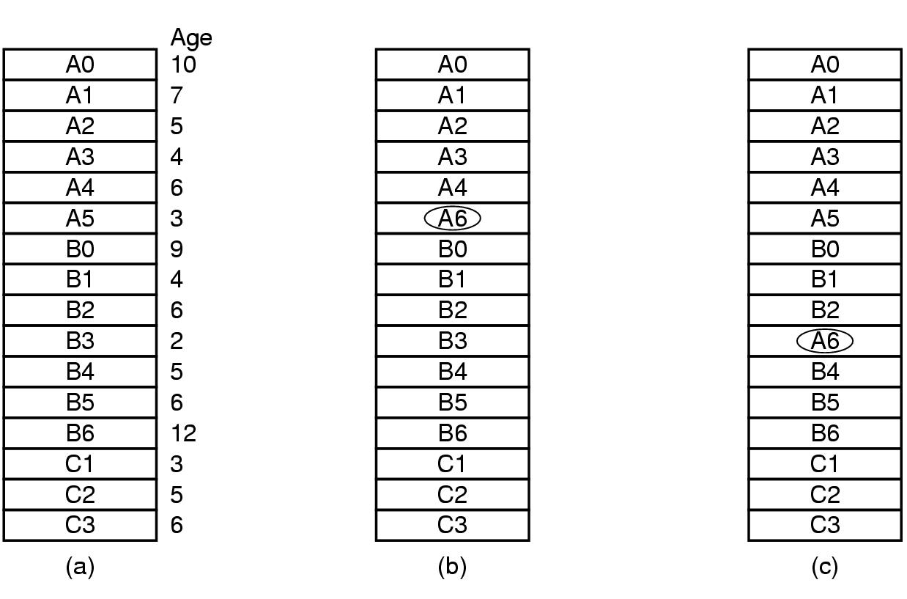
Local vs. global page replacement
Example: Process has a page fault...
Original
Local
Global

Slide 57
Local vs. global page replacement
Assume we have
  5,000 frames in memory
  10 processes
Idea: Give each process 500 frames
Fairness?
  Small processes: do not need all those pages
  Large processes: may benefit from even more frames
Idea:
  Look at the size of each process (… but how?)
  Give them a pro-rated number of frames
  With a minimum of (say) 10 frames per process

Slide 58
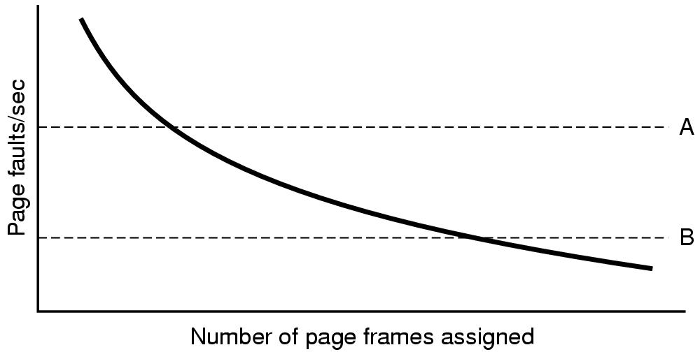
Page fault frequency
“If you give a process more pages,
  its page fault frequency will decline.”

Slide 59
Page fault frequency
“If you give a process more pages,
  its page fault frequency will decline.”
Too High: Need to give this
process some more frames!
Too Low: Take some frames
away and give to other processes!

Slide 60
Page fault frequency
Measure the page fault frequency of each process.
Count the number of faults every second.
May want to consider the past few seconds as well.

Slide 61
Page fault frequency
Measure the page fault frequency of each process.
Count the number of faults every second.
May want to consider the past few seconds as well.
Aging:
  Keep a running value.
  Every second
    Count number of page faults
    Divide running value by 2
    Add in the count for this second

Slide 62
Load control
Assume:
  The best page replacement algorithm
  Optimal global allocation of page frames

Slide 63
Load control
Assume:
  The best page replacement algorithm
  Optimal global allocation of page frames
Thrashing is still possible!

Slide 64
Load control
Assume:
  The best page replacement algorithm
  Optimal global allocation of page frames
Thrashing is still possible!
  Too many page faults!
  No useful work is getting done!
  Demand for frames is too great!

Slide 65
Load Control
Assume:
  The best page replacement algorithm
  Optimal global allocation of page frames
Thrashing is still possible!
  Too many page faults!
  No useful work is getting done!
  Demand for frames is too great!
Solution:
  Get rid of some processes (temporarily).
  Swap them out.
  “Two-level scheduling”

Slide 66
Spare slides

Slide 67
Belady’s anomaly
If you have more page frames (i.e., more memory)...
  You will have fewer page faults, right???

Slide 68
Belady’s anomaly
If you have more page frames (i.e., more memory)...
  You will have fewer page faults, right???
Not always!

Slide 69
Belady’s anomaly
If you have more page frames (i.e., more memory)...
  You will have fewer page faults, right???
Not always!
Consider FIFO page replacement
Look at this reference string:
  012301401234

Slide 70
Belady’s anomaly
If you have more page frames (i.e., more memory)...
  You will have fewer page faults, right???
Not always!
Consider FIFO page replacement
Look at this reference string
  012301401234
Case 1:
  3 frames available --> 9 page faults
Case 2:
  4 frames available --> 10 page faults

Slide 71
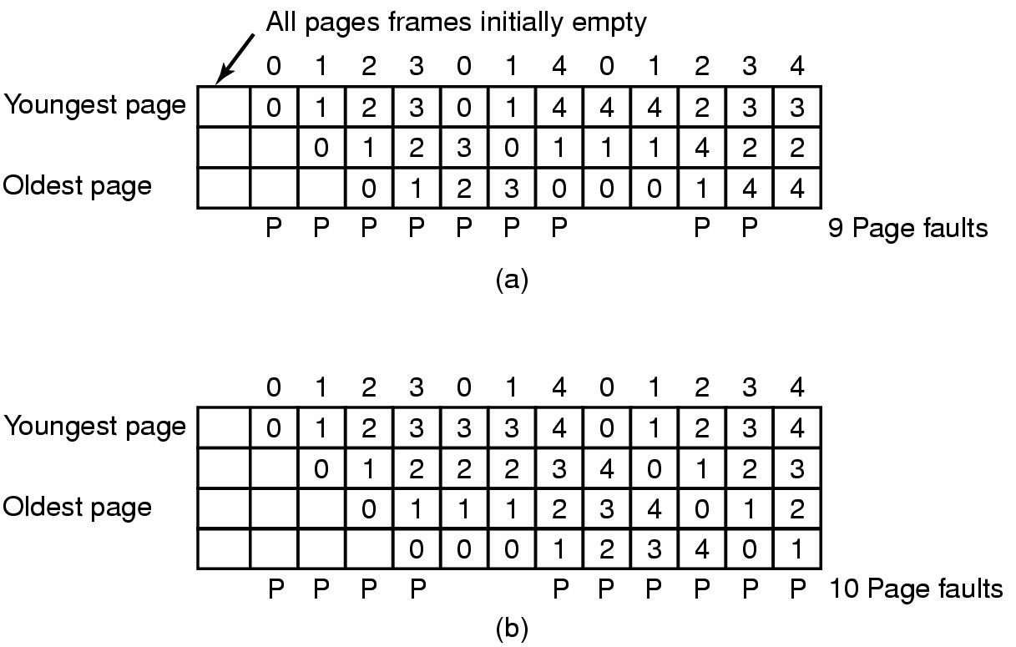
Belady’s anomaly
FIFO with 3 page frames

Slide 72
Belady’s anomaly
FIFO with 3 page frames
FIFO with 4 page frames

Slide 73
Which page size is best?
Smaller page sizes...
  Advantages
    Less internal fragmentation
      On average: half of the last page is wasted
    Working set takes less memory
      Less unused program in memory
  Disadvantages
    Page tables are larger
    Disk-seek time dominates transfer time (It takes the same time to read a large page as a small page)

Slide 74
Which page size is best?
Let
  s = size of average process
  e = bytes required for each page table entry
  p = size of page, in bytes
  s/p = Number of pages per process
  es/p = Size of page table
  p/2 = space wasted due to internal fragmentation
  overhead = se/p + p/2

Slide 75
Which page size is best?
Overhead = se/p + p/2
Want to choose p to minimize overhead.
Take derivative w.r.t. p and set to zero
  -se/p² + 1/2 = 0
Solving for p...
  p = sqrt (2se)

Slide 76
Which page size is best?
Example:
p = sqrt (2 * 1MB * 8) = 4K

Slide 77
Which page size is best?
Example:
p = sqrt (2 * 8MB * 4) = 8K

